Slide 1
Vessel Path Identification in Short-Sea Shipping iHelm Project 2023
Notes:
I’ll briefly talk about different CAISR+ subprojects.

Slide 2
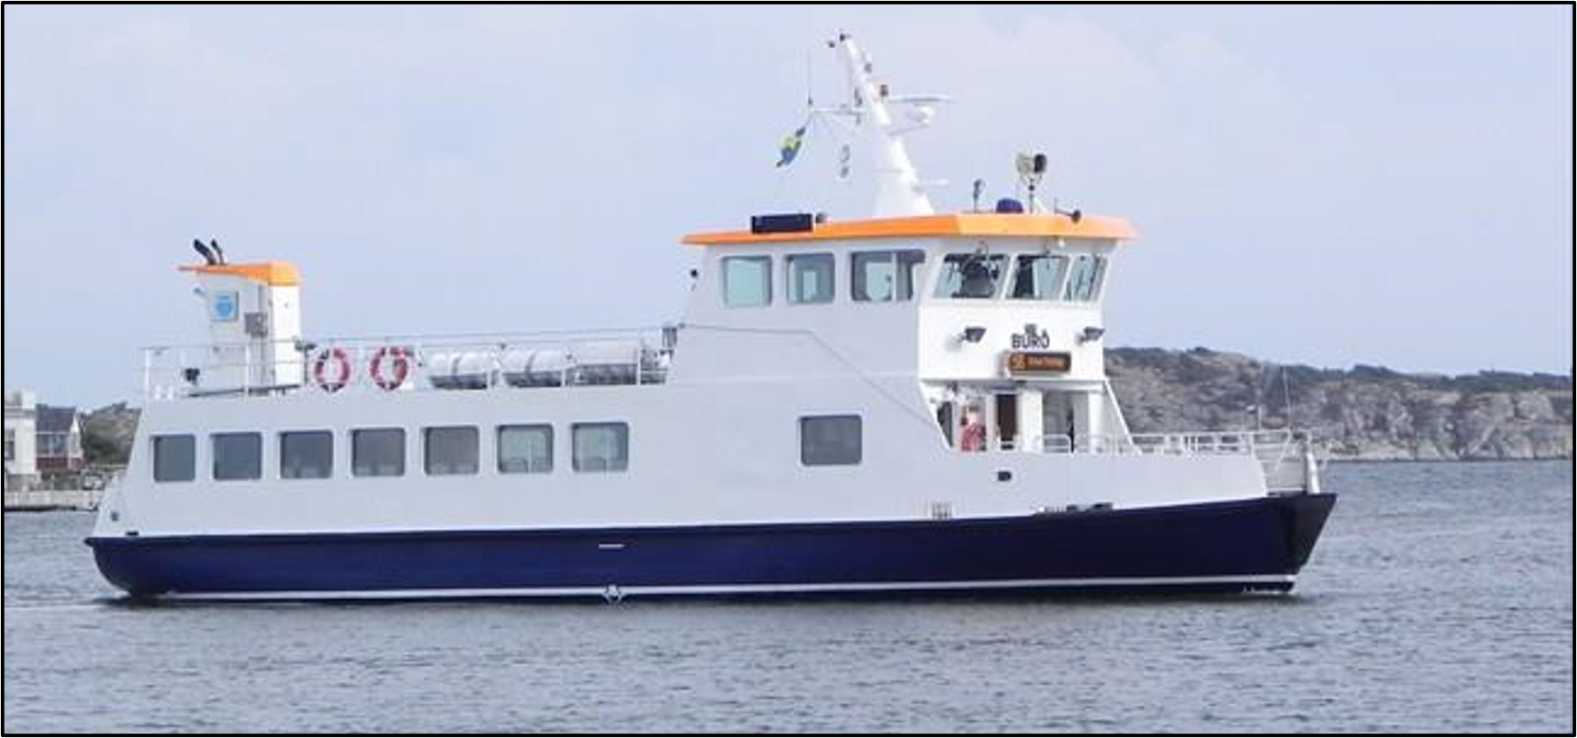
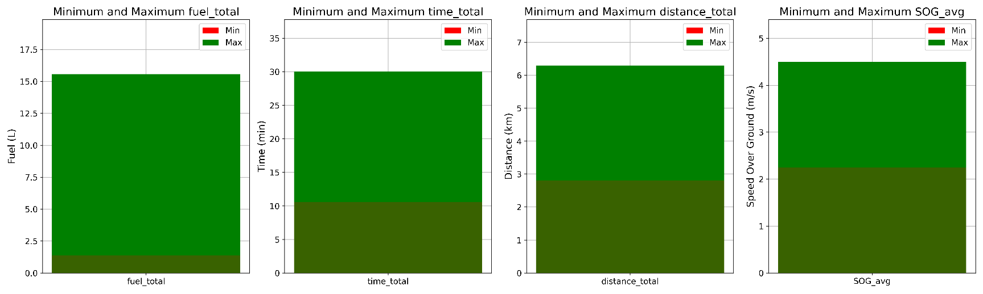
Clustering of Ship Paths
Buro’s Data
Buro
MarineTraffic: Global Ship Tracking Intelligence | AIS Marine Traffic
Vessel Type:Passenger Ship
Size:(Length by Breadth) 19m * 6.41m; MMSI: 265513810
Area: BALTIC - Kattegat
Gross Tonnage: 68
Average Speed recorded 8.2 knots(4.2 m/s)
Draught (Reported/Max): 2.5 m
Flag:Sweden (SE)
The onboard data have been received from our industry partner CetaSol AB in Gothenburg.
The data has been gathered over 15months, 2020 and 2021
39193 Datapoints
1754 Trips
CetaSol AB ." [Online]. Available: https://cetasol.com/ https://www.marinetraffic.com/
Buro_cluster_minmax_fuel_time_dist_sog_v1

Slide 3
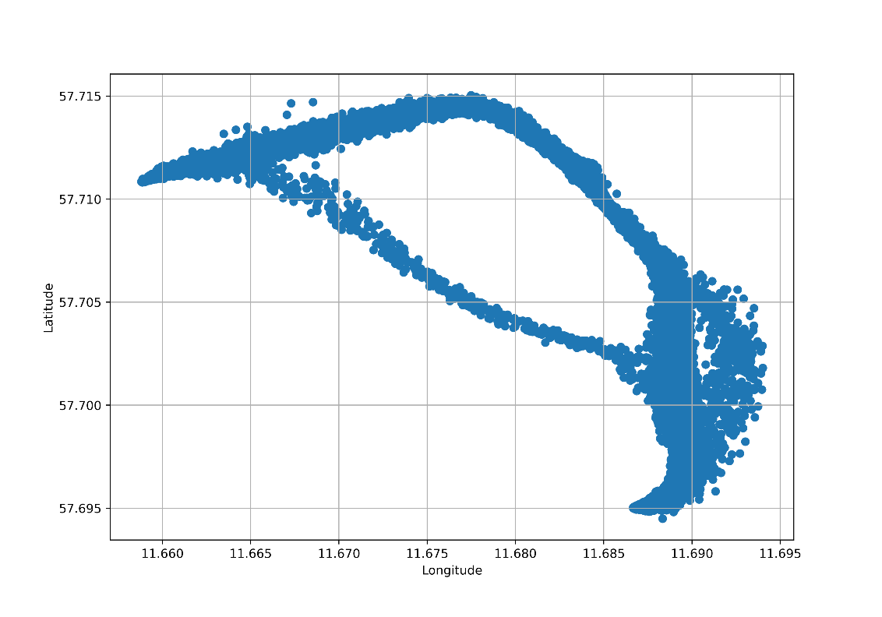
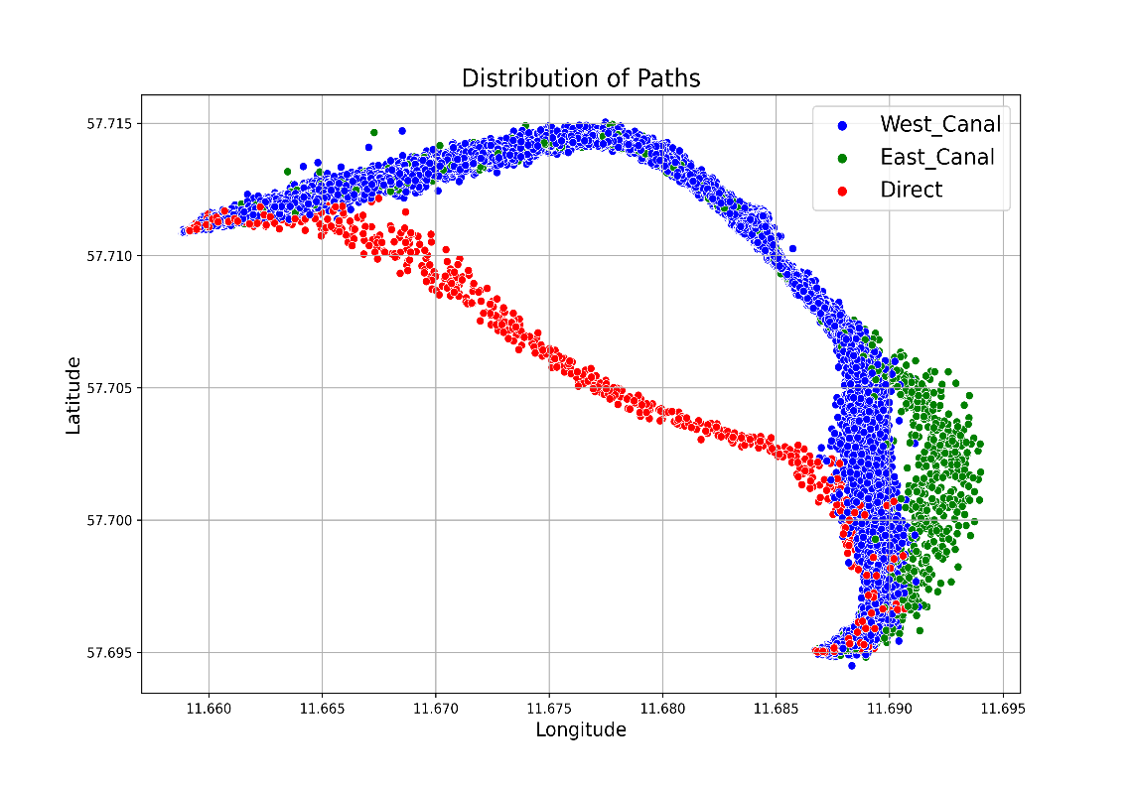
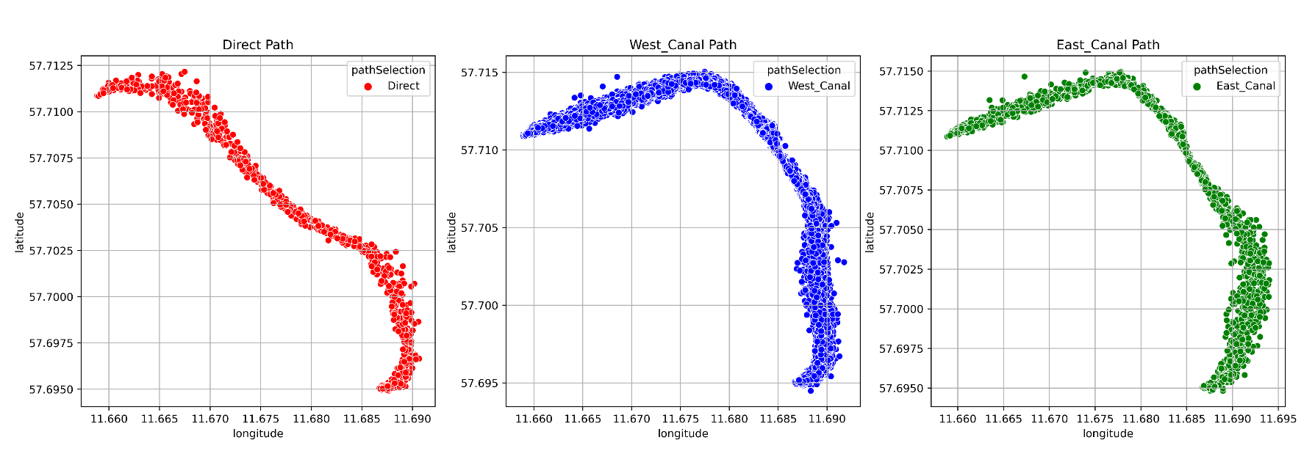
Clustering of Ship Paths
Buro’s Data

Slide 4
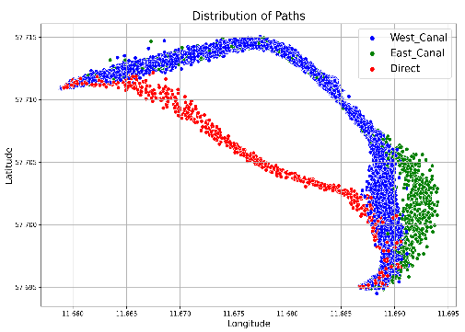
Clustering of Ship Paths
Buro’s Data
Using GMM
To Three Clusters by Distance Matrix
Confusion matrix:
Statistics | Precision | Recall | F1-Score | Support
Direct | 1.000 | 1.000 | 1.000 | 62.000
East_Canal | 0.917 | 1.000 | 0.957 | 122.000
West_Canal | 1.000 | 0.993 | 0.996 | 1571.000
accuracy | 0.994 | 0.994 | 0.994 | 0.994
macro avg | 0.972 | 0.998 | 0.984 | 1755.000
weighted avg | 0.994 | 0.994 | 0.994 | 1755.000
 | Direct | East_Canal | West_Canal
Direct | 62 | 0 | 0
East_Canal | 0 | 122 | 0
West_Canal | 0 | 11 | 1560
Confusion matrix:
To Three Clusters with Gaussian in Six Segments
 | Direct | East_Canal | West_Canal
Direct | 62 | 0 | 0
East_Canal | 0 | 122 | 0
West_Canal | 0 | 0 | 1571
Statistics | Precision | Recall | F1-Score | Support
Direct | 1.0 | 1.0 | 1.0 | 62.0
East_Canal | 1.0 | 1.0 | 1.0 | 122.0
West_Canal | 1.0 | 1.0 | 1.0 | 1571.0
accuracy | 1.0 | 1.0 | 1.0 | 1.0
macro avg | 1.0 | 1.0 | 1.0 | 1755.0
weighted avg | 1.0 | 1.0 | 1.0 | 1755.0

Slide 5

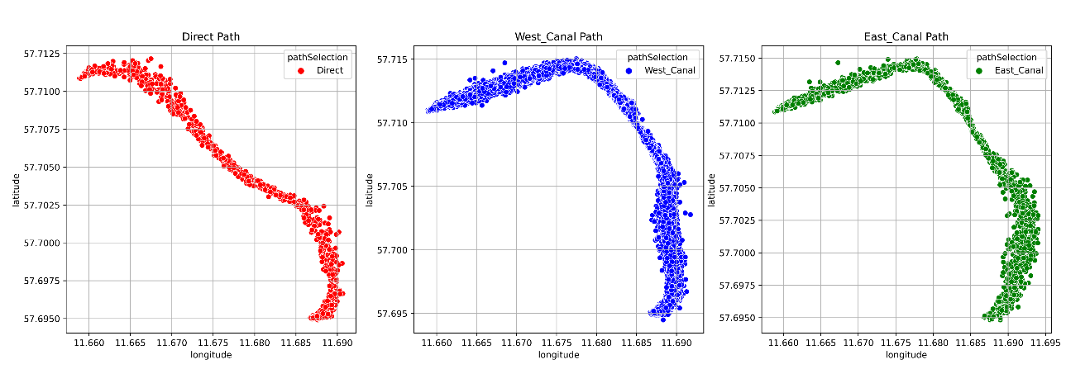
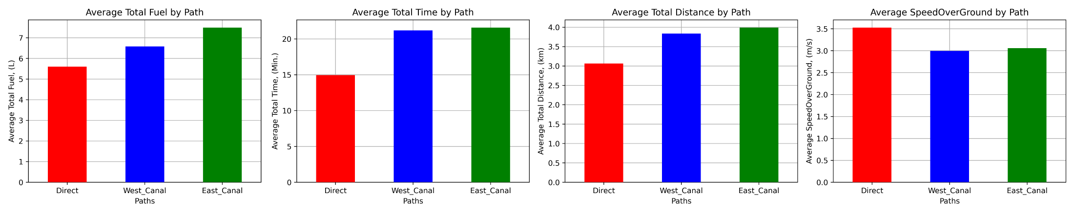
Clustering of Ship Paths
Buro’s Data
39193 Datapoints
1754 sequences (Routes)
Plots_Cruising_Local_Global_Eff_F1_scores_fuel_time_distance_Hists_v2

Slide 6
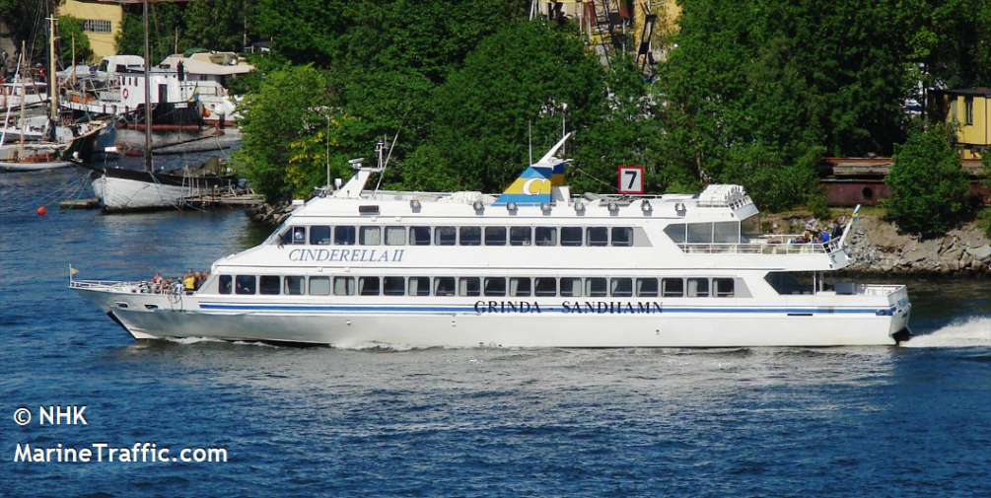
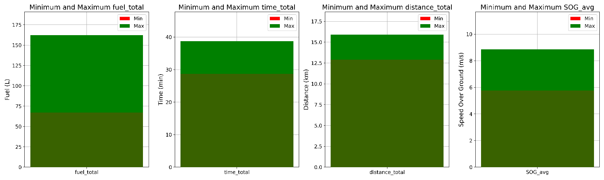
Clustering of Ship Paths
Let’s cluster ship paths
with a new data
Cinderella II
MarineTraffic: Global Ship Tracking Intelligence | AIS Marine Traffic
Vessel Type:
Passenger Ship
Length × Breadth:
41.76x7.68
MMSI: 265609540
Gross Tonnage: 324
Speed recorded (Max / Average): 20.2 knots / 10.4 knots
Draught (Reported/Max): 1.2 m
Flag:Sweden (SE)
The onboard data have been received from our industry partner CetaSol AB in Gothenburg.
The data has been gathered over 5months, 2022
243688 Datapoints
124 Trips
CetaSol AB ." [Online]. Available: https://cetasol.com/ https://www.marinetraffic.com/
Cinderella_cluster_Analysis_v1

Slide 7
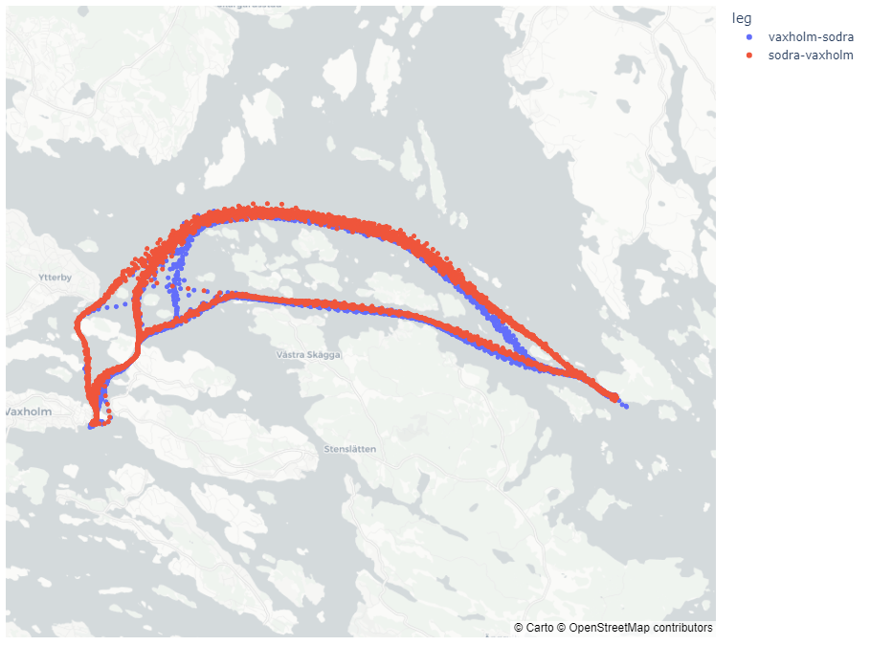
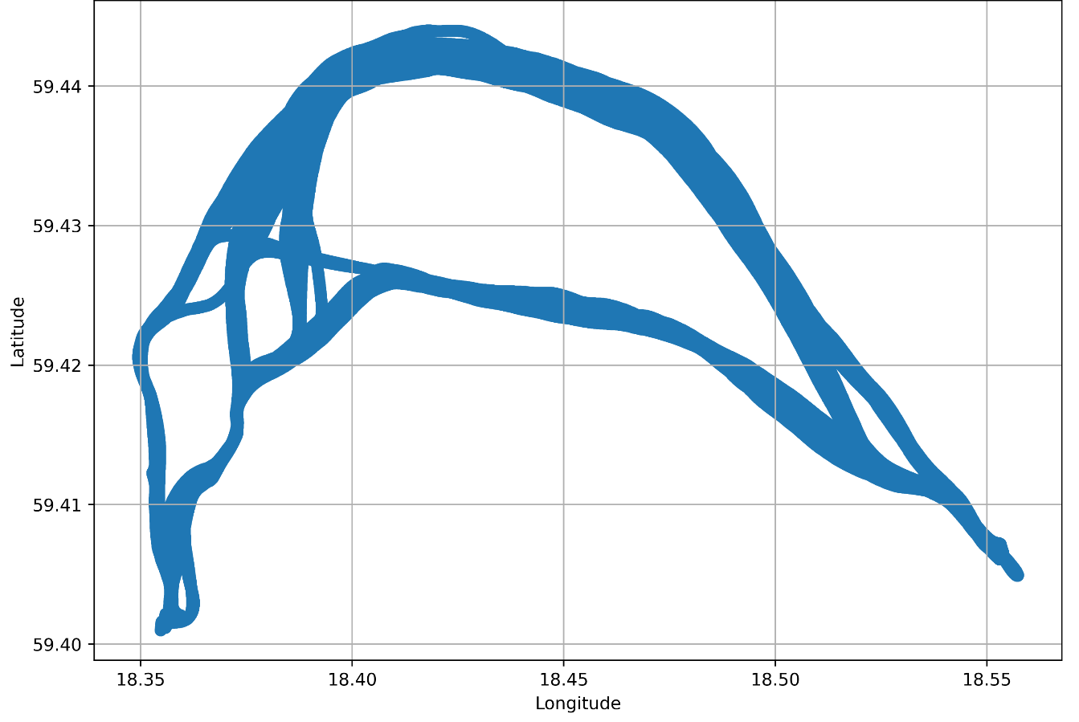
Clustering of Ship Paths
Cinderella
Cluster ship paths
with a new data
Vessel name: Cinderella II
Ports are Vaxhom and Sodra (East of Stockholm, Baltic Sea)
From July 1 to November 6th, 2022.
Temporal Resolution 1second
243688 Datapoints
124 Trips
Cinderella_cluster_Weathers_Preprocessing_v1

Slide 8
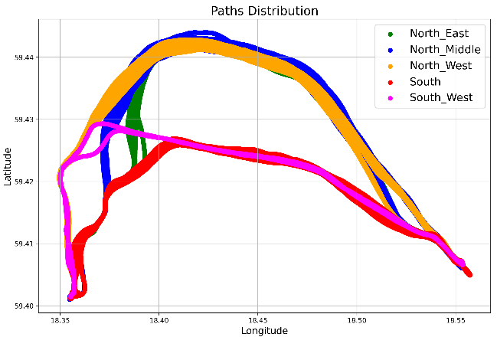
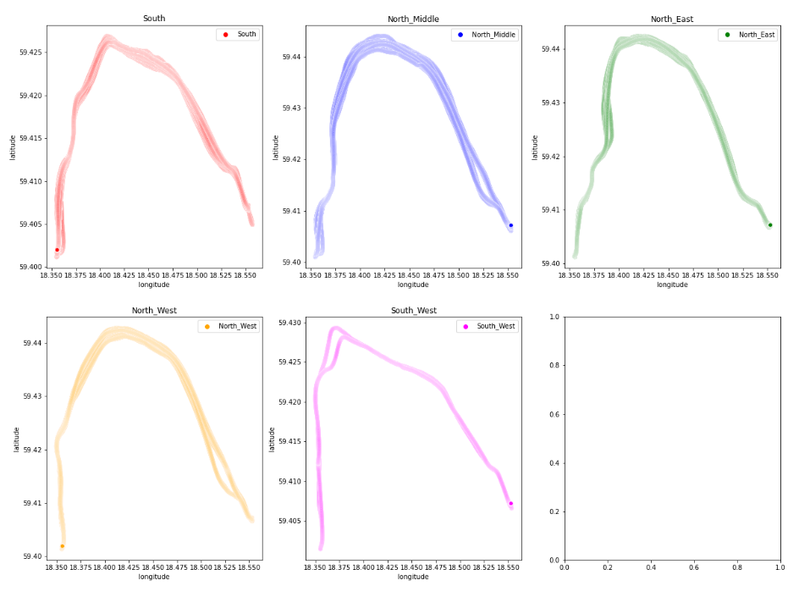
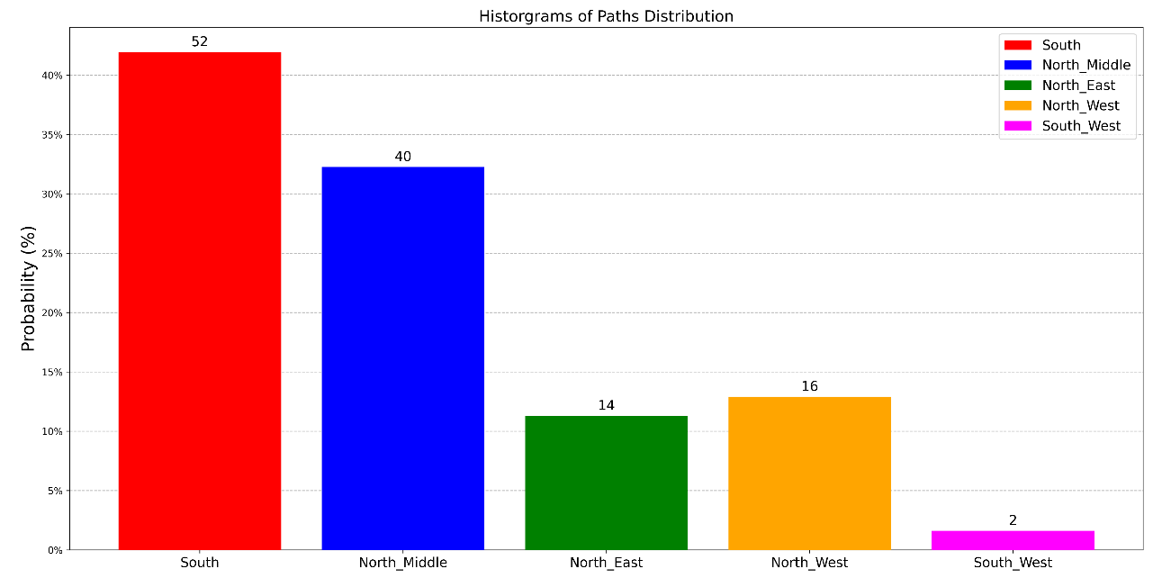
Clustering of Ship Paths
Cinderella
Cluster ship paths
with a new data
Cinderella_cluster_Analysis_v1

Slide 9
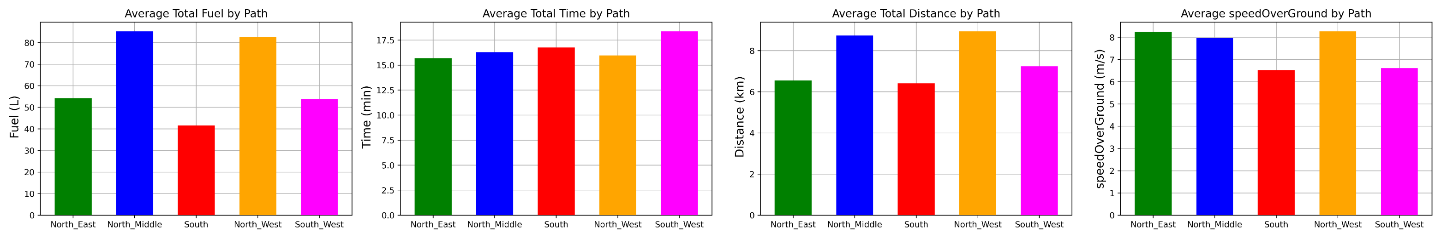
Clustering of Ship Paths
Cinderella
Cluster ship paths
with a new data
Statistics of Path Segments
Cinderella_cluster_Analysis_v1

Slide 10
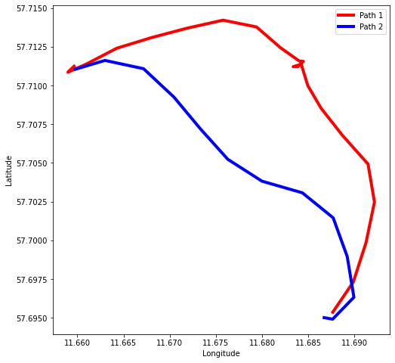
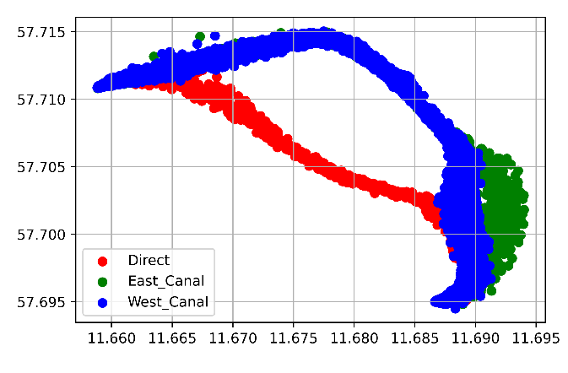
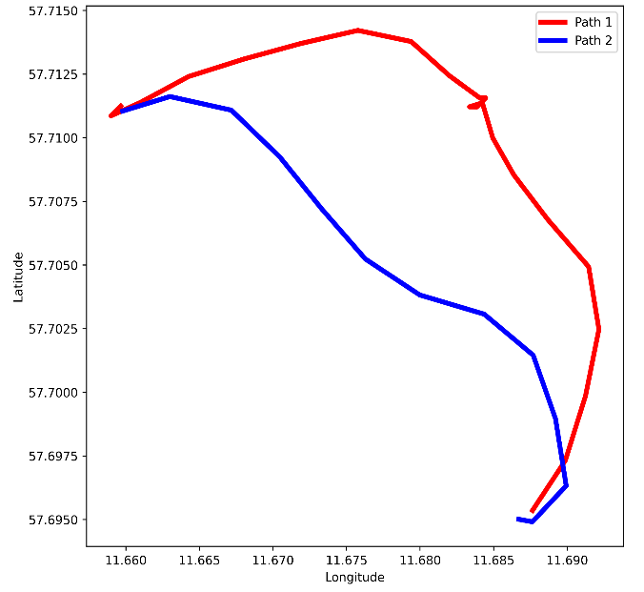
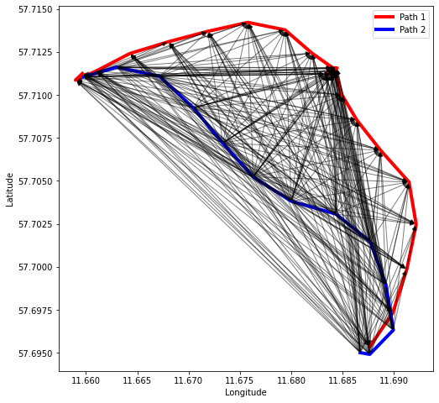
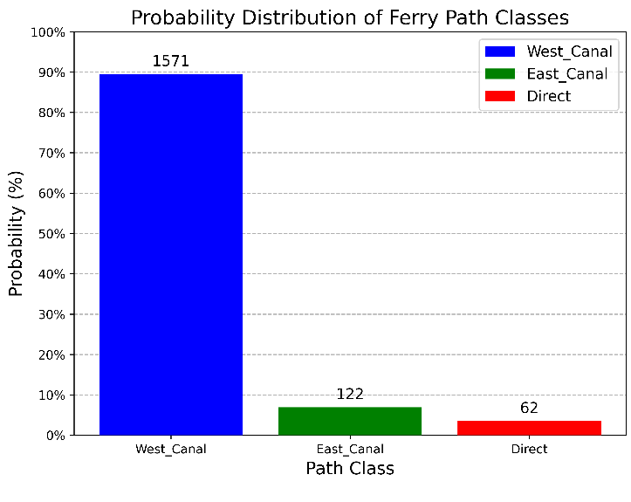
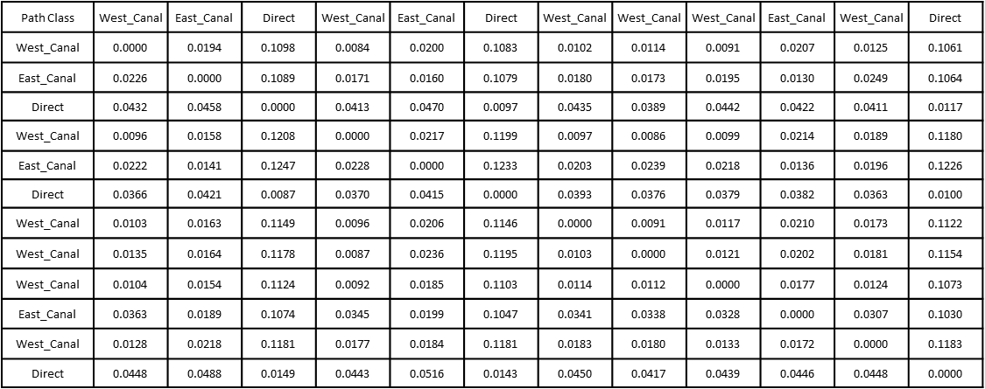
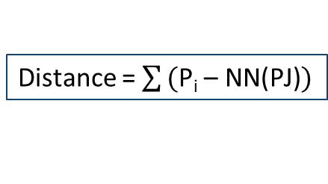
Clustering of Ship Paths
Buro’s Data
Clustering
by Distance Matrix
Buro’s Data
Distance = $\sum{\text{(}\text{P}\text{i}\text{ – }\text{NN}\text{(}\text{PJ}\text{)})}$

Slide 11

Clustering of Ship Paths
Cinderella
Clustering
by Distance Matrix
To Five Clusters
K-Means
Confusion Matrix | Pred. North_East | Pred. North_Middle | Pred. North_West | Pred. South | Pred. South_West
North_ East | 14 | 0 | 0 | 0 | 0
North_ Middle | 6 | 34 | 0 | 0 | 0
North_ West | 0 | 0 | 16 | 0 | 0
South | 0 | 0 | 0 | 52 | 0
South_ West | 0 | 0 | 0 | 0 | 2
 | Precision | Recall | F1-score | Support
North_East | 0.700 | 1.000 | 0.824 | 14.000
North_Middle | 1.000 | 0.850 | 0.919 | 40.000
North_West | 1.000 | 1.000 | 1.000 | 16.000
South | 1.000 | 1.000 | 1.000 | 52.000
South_West | 1.000 | 1.000 | 1.000 | 2.000
accuracy | 0.952 | 0.952 | 0.952 | 0.952
macro avg | 0.940 | 0.970 | 0.948 | 124.000
weighted avg | 0.966 | 0.952 | 0.954 | 124.000
Cinderella_cluster_by_distance_v4

Slide 12
Clustering of Ship Paths
Cinderella
Clustering
by Distance Matrix
To Five Clusters
GMM
Confusion Matrix | Pred. North_East | Pred. North_Middle | Pred. North_West | Pred. South | Pred. South_West
North_ East | 14 | 0 | 0 | 0 | 0
North_ Middle | 6 | 34 | 0 | 0 | 0
North_ West | 0 | 0 | 16 | 0 | 0
South | 0 | 0 | 0 | 52 | 0
South_ West | 0 | 0 | 0 | 0 | 2
 | Precision | Recall | F1-score | Support
North_East | 0.700 | 1.000 | 0.824 | 14.000
North_Middle | 1.000 | 0.850 | 0.919 | 40.000
North_West | 1.000 | 1.000 | 1.000 | 16.000
South | 1.000 | 1.000 | 1.000 | 52.000
South_West | 1.000 | 1.000 | 1.000 | 2.000
accuracy | 0.952 | 0.952 | 0.952 | 0.952
macro avg | 0.940 | 0.970 | 0.948 | 124.000
weighted avg | 0.966 | 0.952 | 0.954 | 124.000
Cinderella_cluster_by_distance_v4

Slide 13
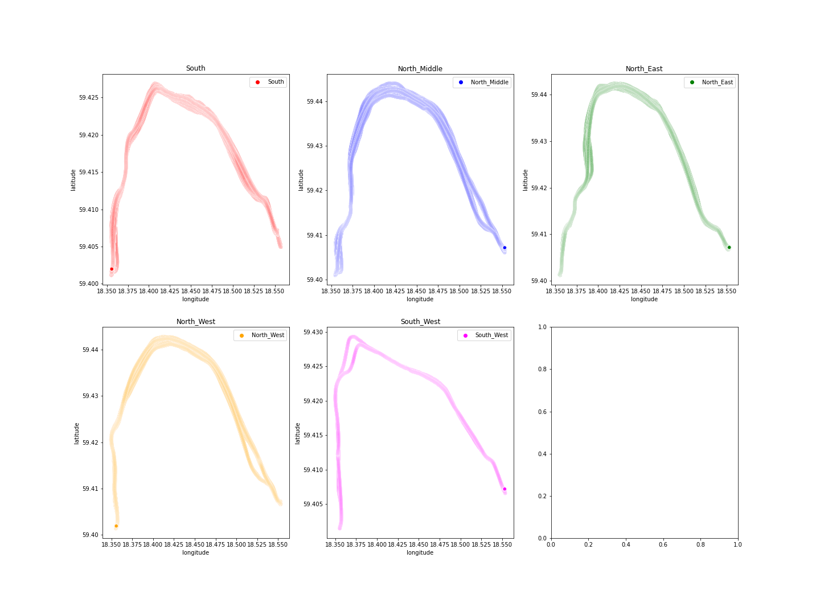
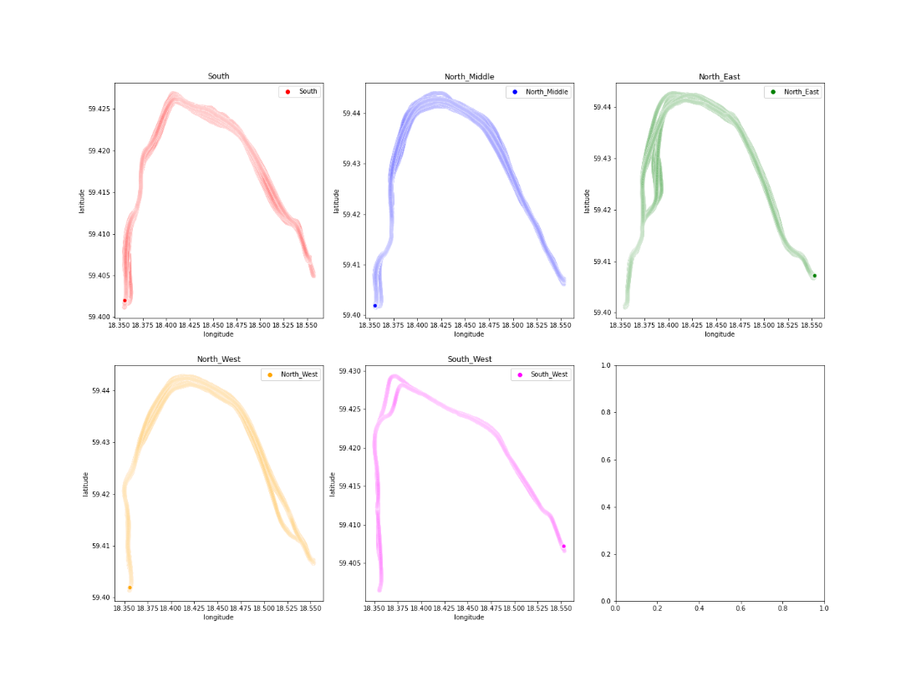

Clustering of Ship Paths
Cinderella
Clustering
by Distance Matrix
To Five Clusters
Actual Paths
Predicted Paths from (K-means and GMM)
Cinderella_cluster_by_distance_v4

Slide 14
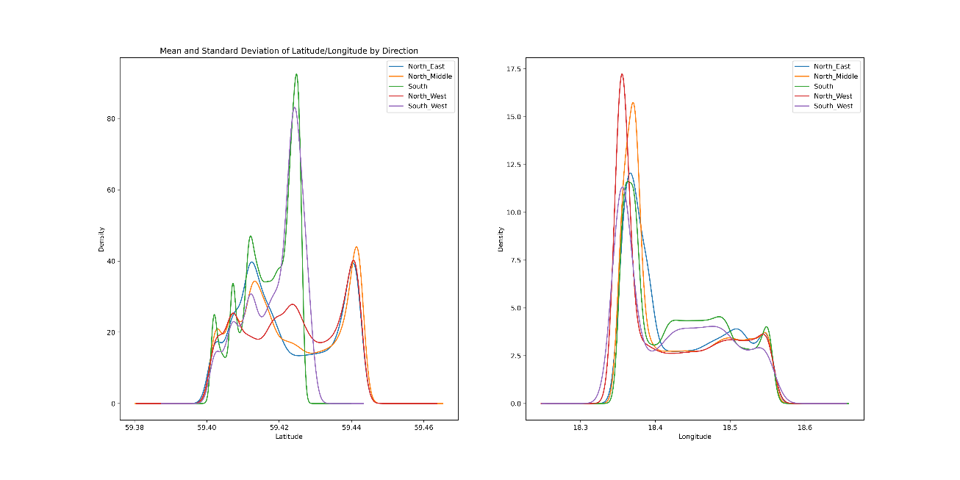
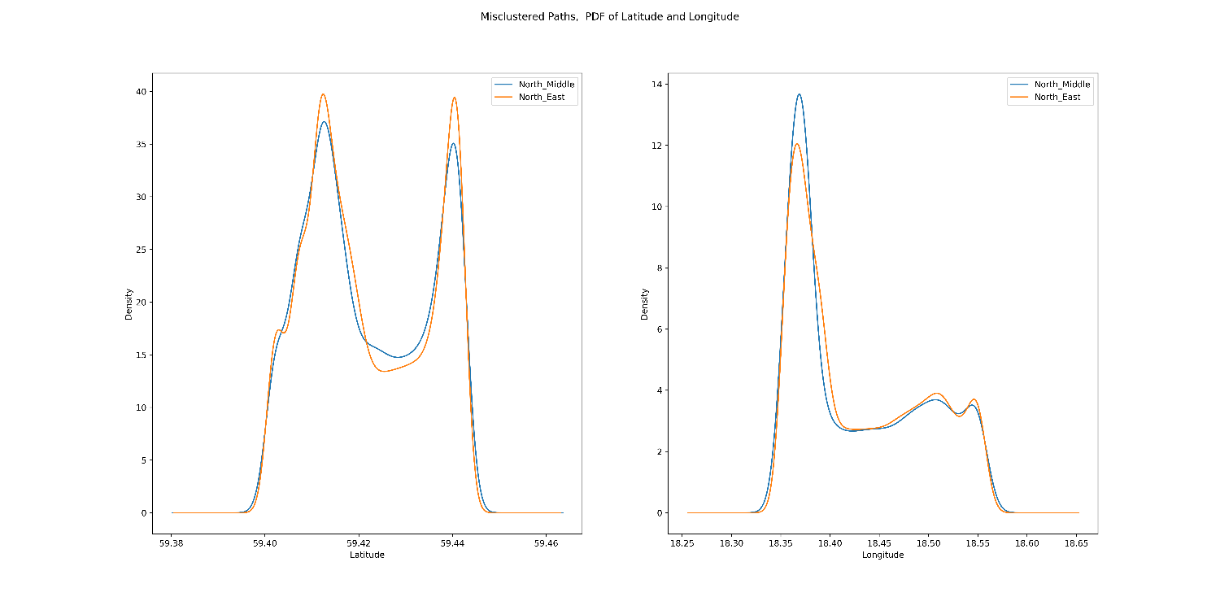
Clustering of Ship Paths
Cinderella
Clustering
by Distance Matrix
To Five Clusters
K-Means and GMM
PDF for correct-clustered paths
PDF for misclustered paths
Cinderella_cluster_by_distance_v4

Slide 15
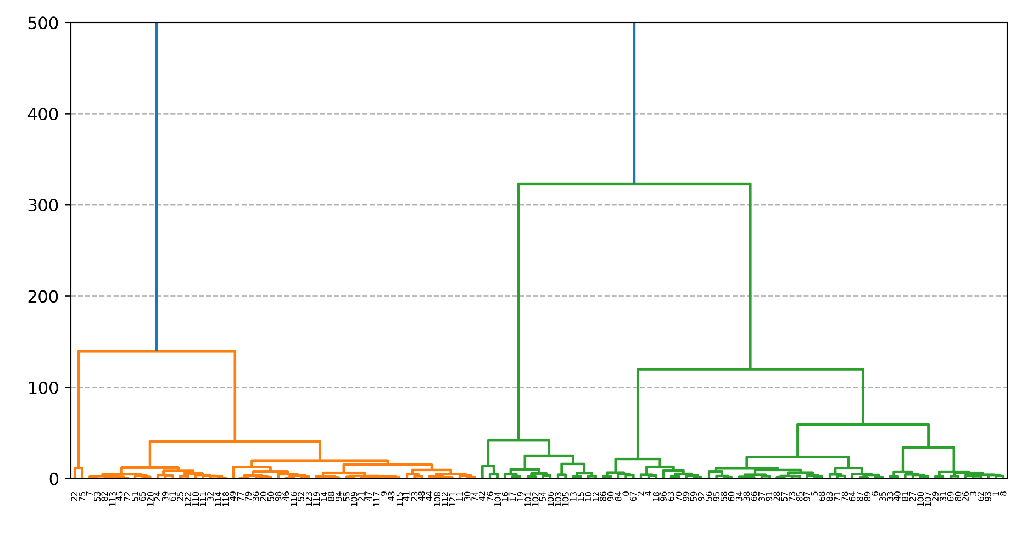
Clustering of Ship Paths
Cinderella
Clustering
by Distance Matrix
To Five Clusters
Hierarchical Clustering
Cinderella_cluster_by_distance_v4

Slide 16
Clustering of Ship Paths
Cinderella
Clustering
by Distance Matrix
To Five Clusters
Hierarchical Clustering
Confusion Matrix | Pred. North_East | Pred. North_Middle | Pred. North_West | Pred. South | Pred. South_West
North_ East | 14 | 0 | 0 | 0 | 0
North_ Middle | 0 | 40 | 0 | 0 | 0
North_ West | 0 | 0 | 16 | 0 | 0
South | 0 | 0 | 0 | 52 | 0
South_ West | 0 | 0 | 0 | 0 | 2
 | Precision | Recall | F1-score | Support
North_East | 1.0 | 1.0 | 1.0 | 14.0
North_Middle | 1.0 | 1.0 | 1.0 | 40.0
North_West | 1.0 | 1.0 | 1.0 | 16.0
South | 1.0 | 1.0 | 1.0 | 52.0
South_West | 1.0 | 1.0 | 1.0 | 2.0
accuracy | 1.0 | 1.0 | 1.0 | 1.0
macro avg | 1.0 | 1.0 | 1.0 | 124.0
weighted avg | 1.0 | 1.0 | 1.0 | 124.0
Cinderella_cluster_by_distance_v4

Slide 17

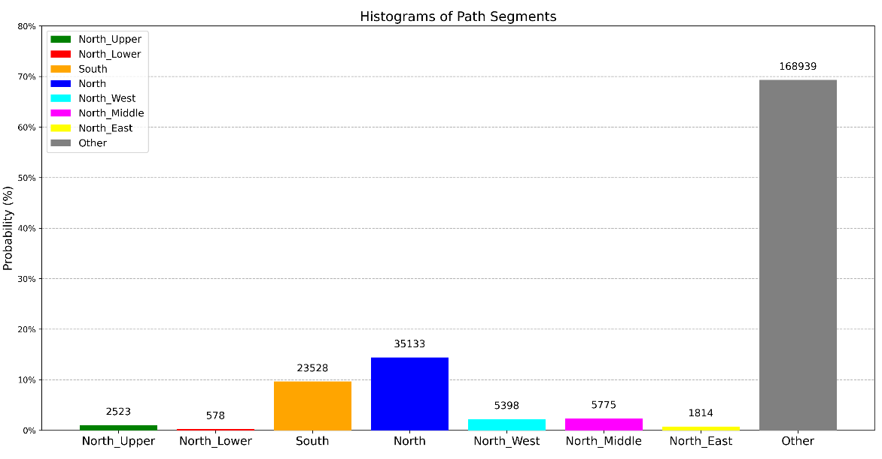
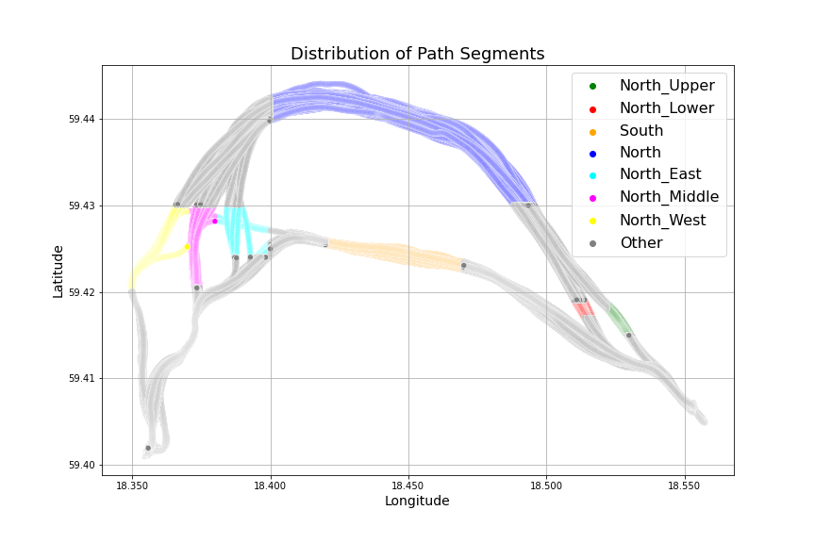
Clustering
by Gaussians
To Five Clusters
with 8 segments
Clustering of Ship Paths
Cinderella
Statistics of Path Segments
index | segment | Latitude _mean | Latitude _std | Longitude _mean | Longitude _std
1 | North | 59.4390 | 0.0035 | 18.4474 | 0.0269
2 | North_East | 59.4260 | 0.0018 | 18.3920 | 0.0059
3 | North_Lower | 59.4180 | 0.0006 | 18.5135 | 0.0014
4 | North_Middle | 59.4249 | 0.0027 | 18.3730 | 0.0013
5 | North_Upper | 59.4167 | 0.0010 | 18.5260 | 0.0023
6 | North_West | 59.4245 | 0.0025 | 18.3571 | 0.0053
7 | South | 59.4243 | 0.0008 | 18.4450 | 0.0145
8 | Other | 59.4154 | 0.0089 | 18.4270 | 0.0740
Cinderella_cluster_by_Gaussian_8segments_v2

Slide 18
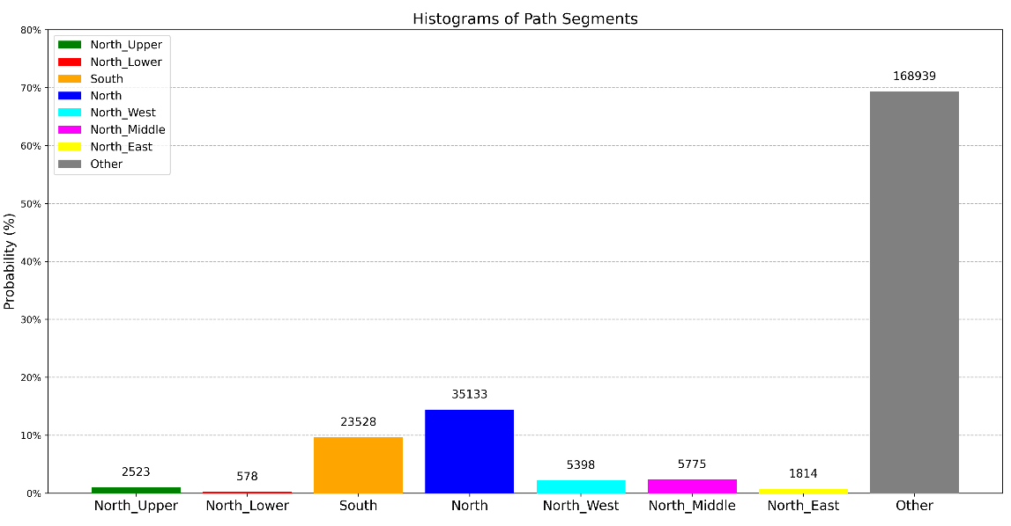
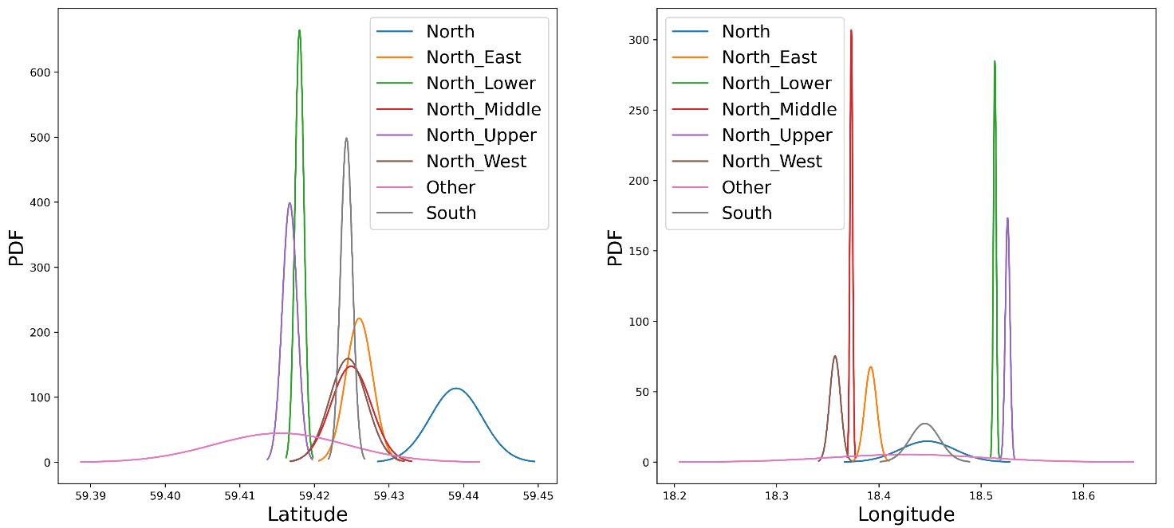
Clustering
by Gaussians
To Five Clusters
with 8 segments
Clustering of Ship Paths
Cinderella
Statistics of the Clustering Results
Cinderella_cluster_by_Gaussian_8segments_v2

Slide 19
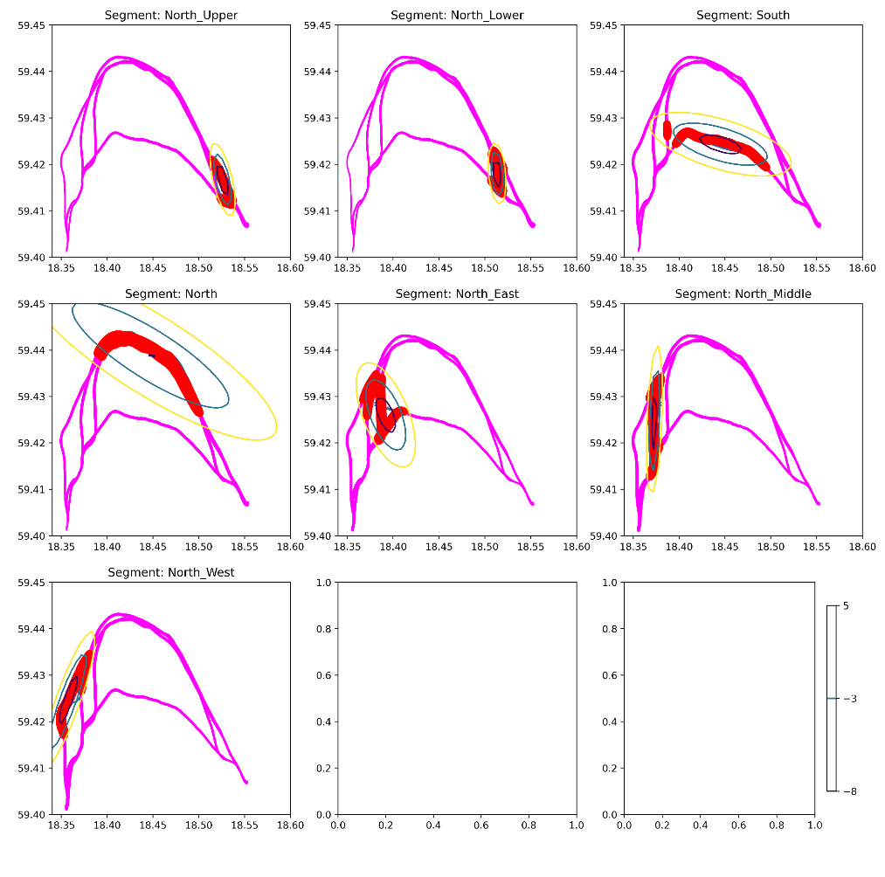

Clustering
by Gaussians
To Five Clusters
with 8 segments
Clustering of Ship Paths
Cinderella
Cinderella_cluster_by_Gaussian_8segments_v2

Slide 20
Clustering
by Gaussians
To Five Clusters
with 8 segments
Clustering of Ship Paths
Cinderella
Confusion Matrix | Pred. North_East | Pred. North_Middle | Pred. North_West | Pred. South | Pred. South_West
North_ East | 14 | 0 | 0 | 0 | 0
North_ Middle | 0 | 40 | 0 | 0 | 0
North_ West | 0 | 0 | 16 | 0 | 0
South | 0 | 0 | 0 | 52 | 0
South_ West | 0 | 0 | 0 | 0 | 2
 | Precision | Recall | F1-score | Support
North_East | 1.0 | 1.0 | 1.0 | 14.0
North_Middle | 1.0 | 1.0 | 1.0 | 40.0
North_West | 1.0 | 1.0 | 1.0 | 16.0
South | 1.0 | 1.0 | 1.0 | 52.0
South_West | 1.0 | 1.0 | 1.0 | 2.0
accuracy | 1.0 | 1.0 | 1.0 | 1.0
macro avg | 1.0 | 1.0 | 1.0 | 124.0
weighted avg | 1.0 | 1.0 | 1.0 | 124.0
Cinderella_cluster_by_Gaussian_8segments_v2

Slide 21
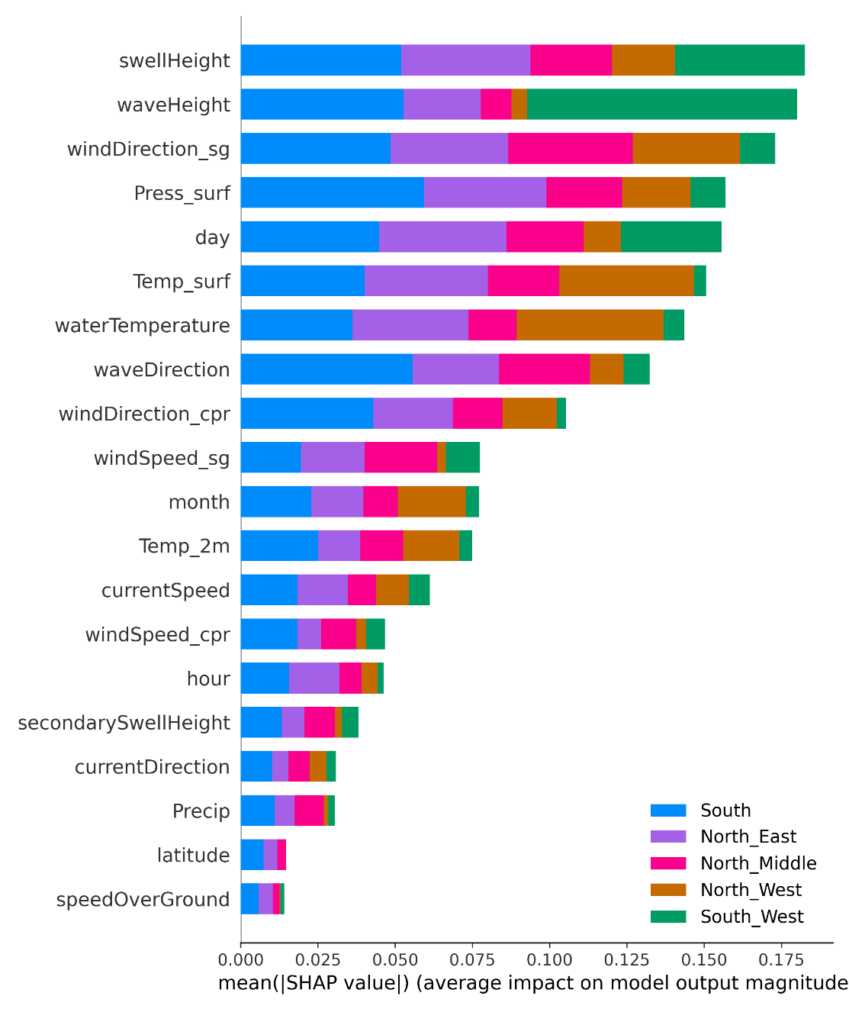

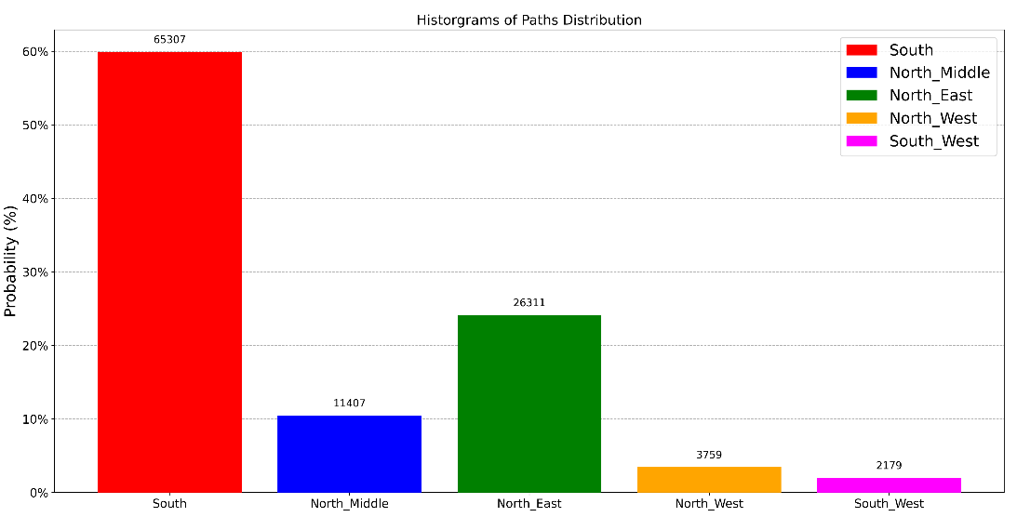
Classification of Ship Paths
Cinderella
To 5 Classes
Cinderella_Classification_v2
Shap Value

Slide 22

Classification of Ship Paths
Cinderella
To 5 Classes
Size(y_test)=21793 out of 108963
Random Random Forest with Balanced Subsampling
Confusion Matrix | Pred. North_East | Pred. North_Middle | Pred. North_West | Pred. South | Pred. South_West
North_East | 5263 | 0 | 0 | 0 | 0
North_Middle | 0 | 2282 | 0 | 0 | 0
North_West | 0 | 0 | 752 | 0 | 0
South | 0 | 0 | 0 | 13062 | 0
South_West | 0 | 0 | 0 | 0 | 436
 | Precision | Recall | F1-score | Support
North_East | 1.0 | 1.0 | 1.0 | 5263.0
North_Middle | 1.0 | 1.0 | 1.0 | 2282.0
North_West | 1.0 | 1.0 | 1.0 | 752.0
South | 1.0 | 1.0 | 1.0 | 13062.0
South_West | 1.0 | 1.0 | 1.0 | 436.0
accuracy | 1.0 | 1.0 | 1.0 | 1.0
macro avg | 1.0 | 1.0 | 1.0 | 21795.0
weighted avg | 1.0 | 1.0 | 1.0 | 21795.0
Cinderella_Classification_v2

Slide 23
Classification of Ship Paths
Cinderella
To 5 Classes
Size(y_test)=21793 out of 108963
Random Random Forest with Balanced Subsampling
Confusion Matrix | Pred. North_East | Pred. North_Middle | Pred. North_West | Pred. South | Pred. South_West
North_East | 5263 | 0 | 0 | 0 | 0
North_Middle | 0 | 2282 | 0 | 0 | 0
North_West | 0 | 0 | 752 | 0 | 0
South | 0 | 0 | 0 | 13062 | 0
South_West | 0 | 0 | 0 | 0 | 436
 | Precision | Recall | F1-score | Support
North_East | 1.0 | 1.0 | 1.0 | 5263.0
North_Middle | 1.0 | 1.0 | 1.0 | 2282.0
North_West | 1.0 | 1.0 | 1.0 | 752.0
South | 1.0 | 1.0 | 1.0 | 13062.0
South_West | 1.0 | 1.0 | 1.0 | 436.0
accuracy | 1.0 | 1.0 | 1.0 | 1.0
macro avg | 1.0 | 1.0 | 1.0 | 21795.0
weighted avg | 1.0 | 1.0 | 1.0 | 21795.0
Uncertainty Analysis
Class North_East: Mean=1.0000, StdDev=0.0009, Median=1.0000, Min=0.9600, Max=1.0000
Class North_Middle: Mean=0.9998, StdDev=0.0064, Median=1.0000, Min=0.7000, Max=1.0000
Class North_West: Mean=0.9999, StdDev=0.0022, Median=1.0000, Min=0.9400, Max=1.0000
Class South: Mean=1.0000, StdDev=0.0003, Median=1.0000, Min=0.9900, Max=1.0000
Class South_West: Mean=1.0000, StdDev=0.0000, Median=1.0000, Min=1.0000, Max=1.0000
Cinderella_Classification_v2

Slide 24
Thanks for your listening Any Qs?
Notes:
I’ll briefly talk about different CAISR+ subprojects.

